Slide 1

Well Come the Protocol Presentation
Presented by:
Fateha Jannat
Registration no: 190302030013
Fall -2019
Masters of Public Health
Department of Public Health
North East University Bangladesh
Guide/Supervisor: Dr. Tanusree Sarkar

Slide 2
“Prevalence of Contraceptive among married women of reproductive age of urban slum in Sylhet City Corporation”.

Slide 3
Introduction
1.
2.
3.
4.
5.
6.

Slide 4
Problem statement:
People in slum area usually have very little idea about contraceptives.
.

Slide 5
Rationale of the research

Slide 6
Literature review:
Ferdousi et al. (2010) identified fear of side effects as a major reason for not using contraceptives (46%) followed by religious reasons (12%) and husbands or family disapproval (11%) .

Slide 7
Objectives:
General objectives:-
1.To identify the Prevalence of Contraceptive among married women of reproductive age of urban slum in Sylhet City Corporation.
Specific Objective:-
1.To evaluate the socio-demographic characteristics.
2.To assess the Contraceptive Prevalence Rate (CPR) in urban slum.

Slide 8
Methodology
Type of Study: The study design is descriptive type of cross sectional one.
Study period: January 2021 to April 2021

Slide 9
Variables:
Socio demographic variables-
1. Age
2. Sex
3. Religion
4. Marital status
5. Occupation
6. Educational qualification
7. Monthly income
8. Family Size

Slide 10
related variables-

Slide 11
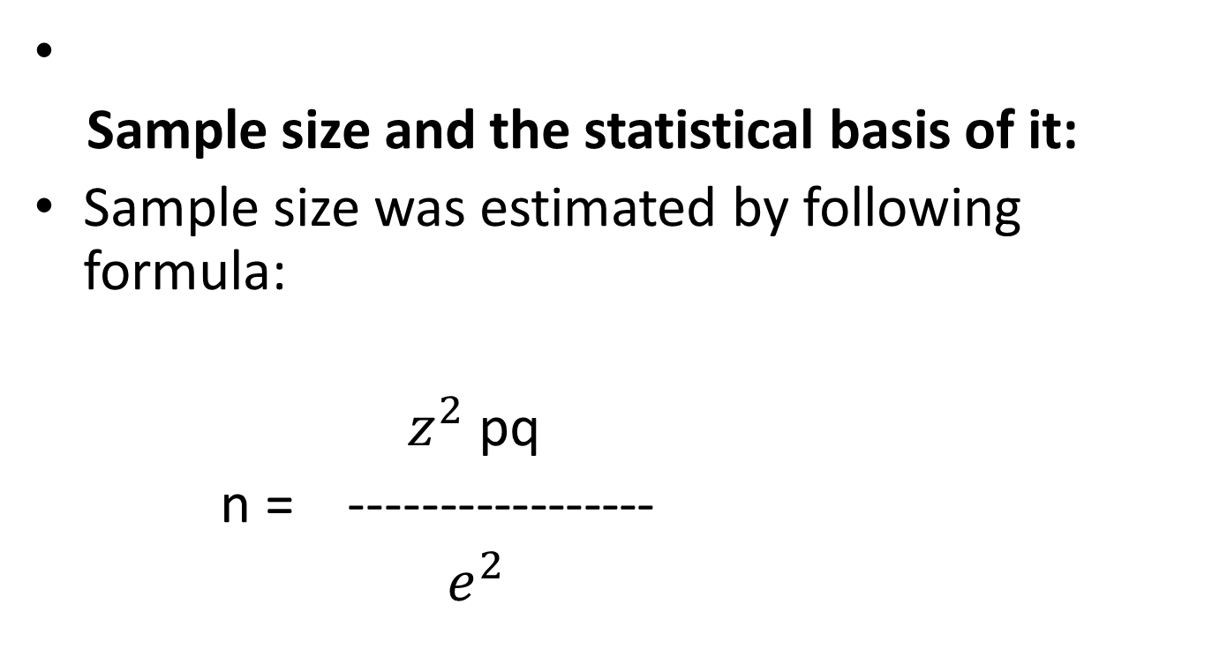
Study population:
Sample size and the statistical basis of it:
Sample size was estimated by following formula:
$z^{2}$pq
n = -----------------
$e^{2}$

Slide 12
Sampling method:
Purposive/ Multistage sampling method will be used.

Slide 13
Criteria for sample selection
Inclusive criteria:-
1. Reproductive age group (15-49) years.
2. Those who are willing to participate in the study.
Exclusive criteria:
Those who are not willing to participate in the study.
Data will not be collected from the widows and divorced women
Severely ill person.
Mentally disoriented.

Slide 14
Method of data collection:
Face to face interview.
Permission and purpose of the study will be taken from respondents.
Respondents will be given full assurance on some ethical point of view that under no circumstances any part of the interview will not be disclosed to any unauthorized person.

Slide 15
Research question:
What is the ------------at urban slum area in Sylhet City Corporation?

Slide 16
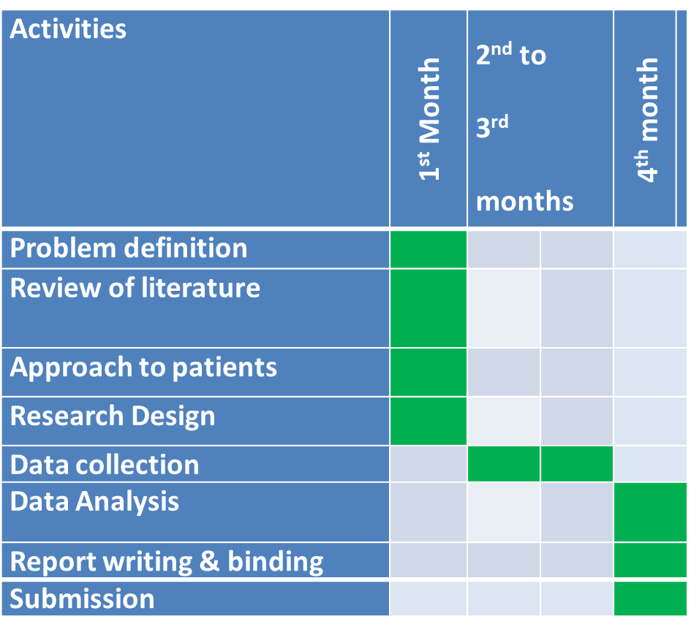
Work frame

Slide 17
Reference

Slide 19


